Slide 1
Data Science Mid Project Report
Dasari Sai Harsh-2022144
Chandan Sah-2022140
Aditya Upadhyay-2022040
Aditya Aggarwal-2022028

Slide 2
Problem Statement
To predict the Air Quality Index (AQI) in a city over a specified period by analyzing time-series data of various chemical pollutants, identifying interdependencies among them to optimize feature selection and improve model accuracy.

Slide 3
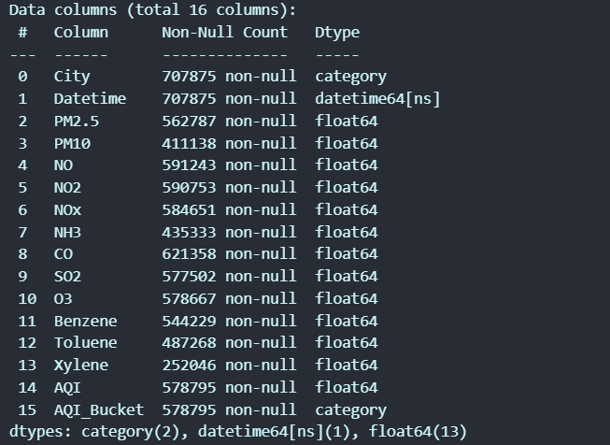
Dataset Overview
Air Quality Dataset
Description: A comprehensive dataset of air quality measurements from multiple cities.
Key Features:
Data Points: 707,875 entries
City: Categorical (City name)
Datetime: Timestamp of measurement
Pollutants: PM2.5, PM10, NO, NO2, NOx, NH3, CO, SO2, O3, Benzene, Toluene, Xylene
Labels: AQI (Air Quality Index), AQI_Bucket (Categorical quality levels)
There are Many Missing values present in dataset which need to be checked while in Preprocessing of this raw data.

Slide 4
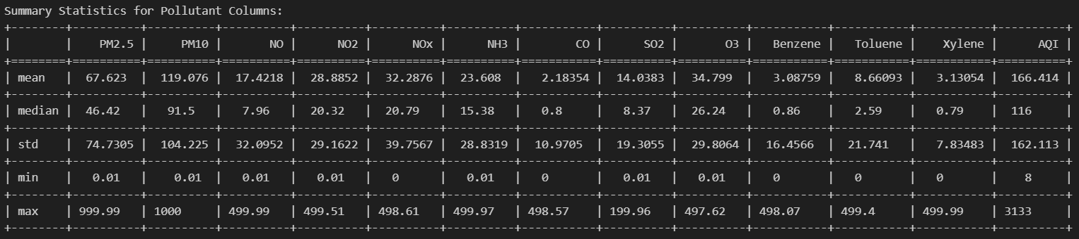
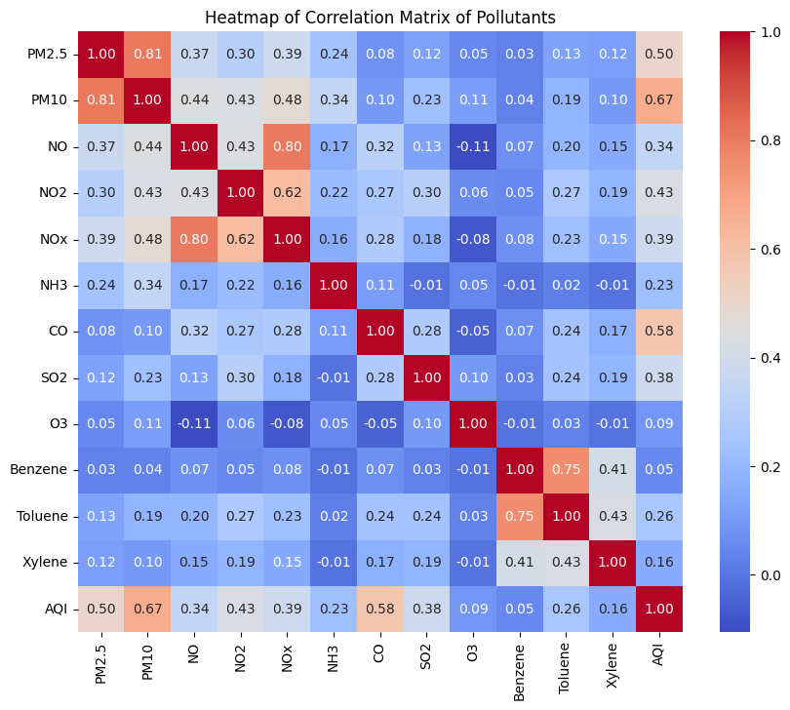
EDA - Statistical Summary

Slide 5
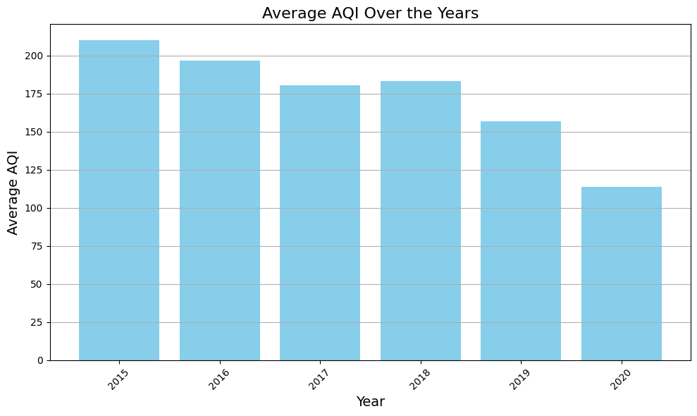
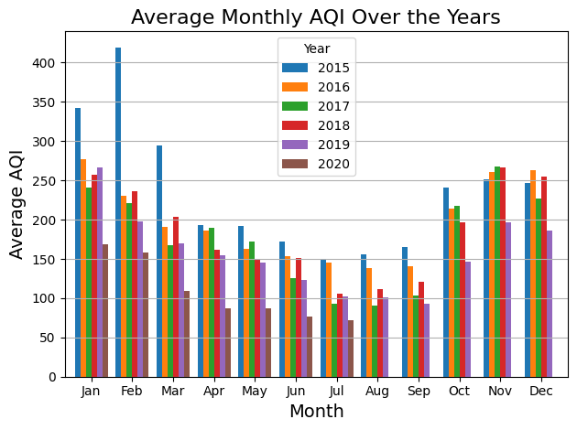
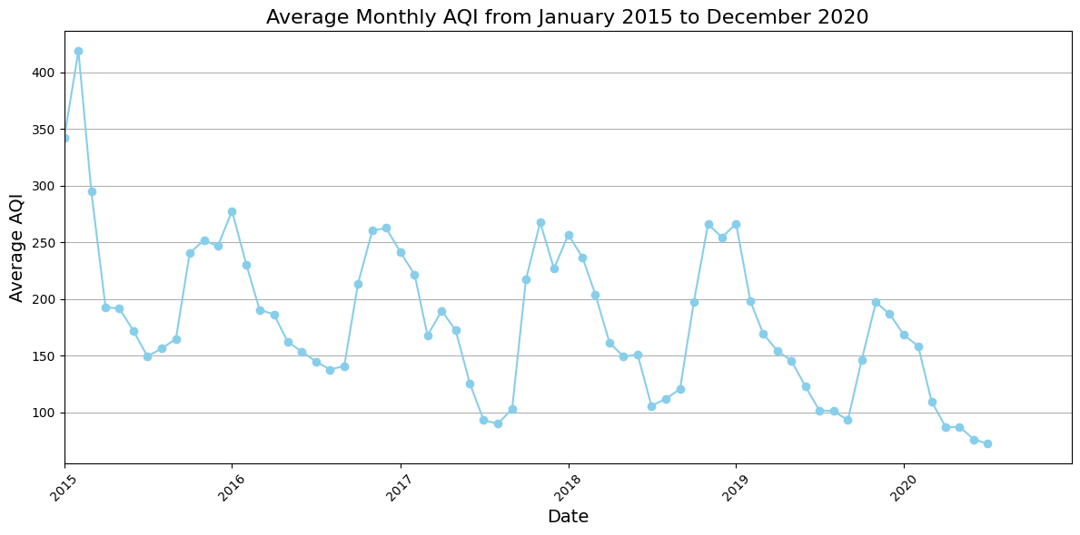
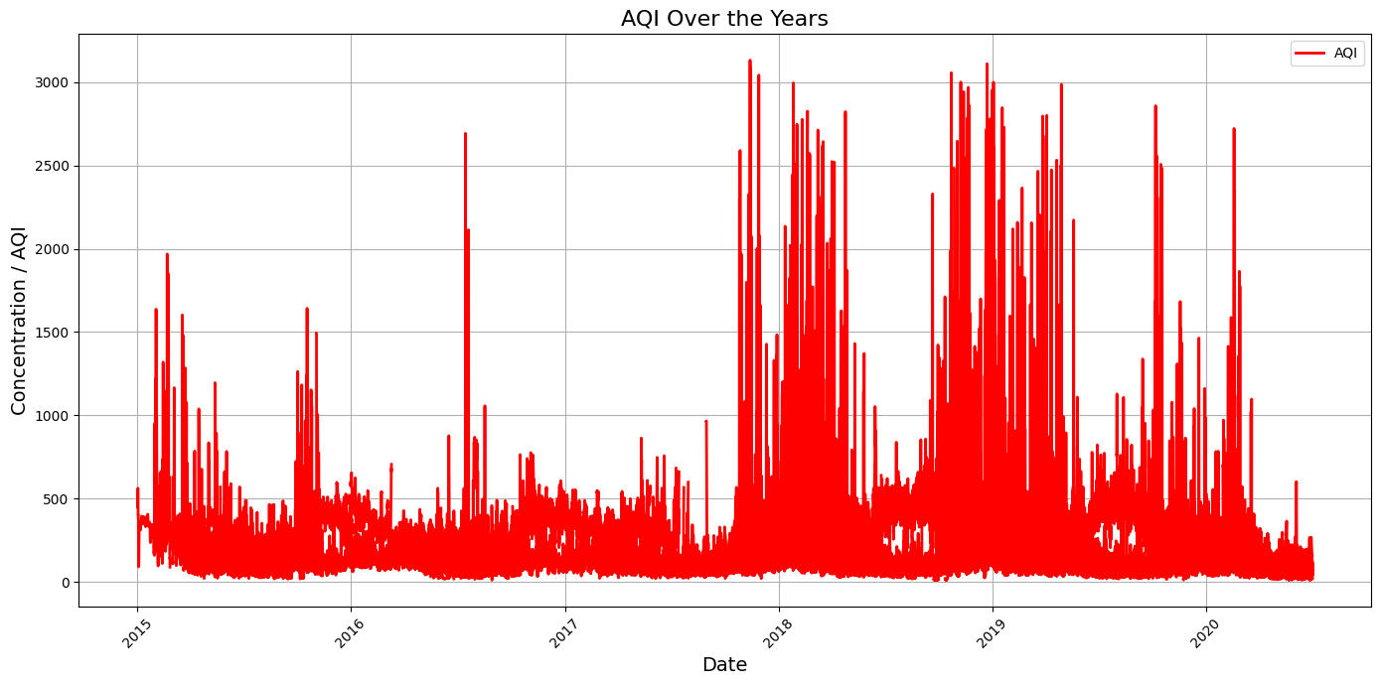
EDA - Time-Series Analysis

Slide 6
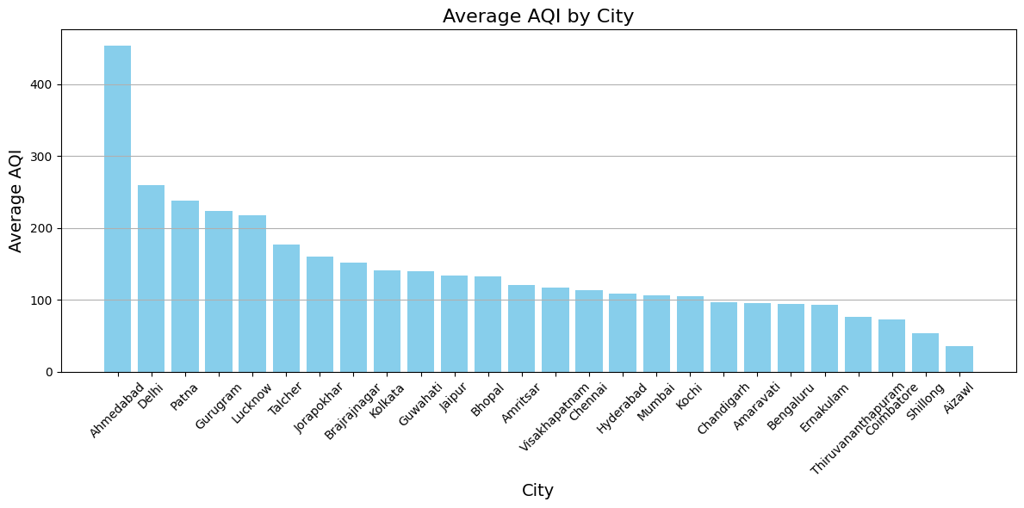
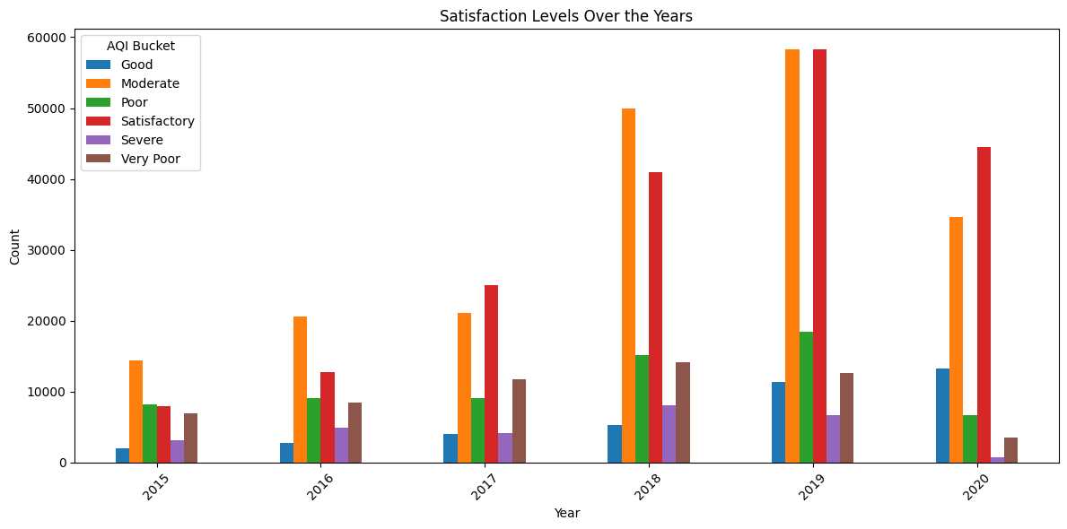
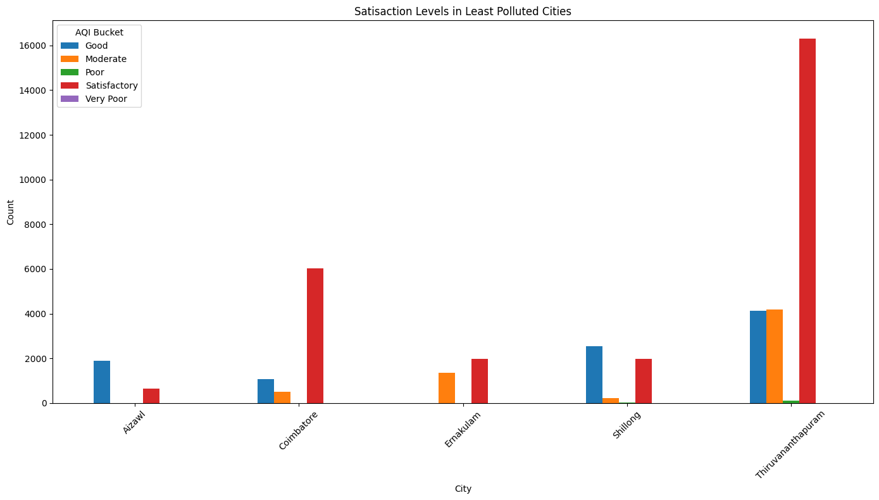
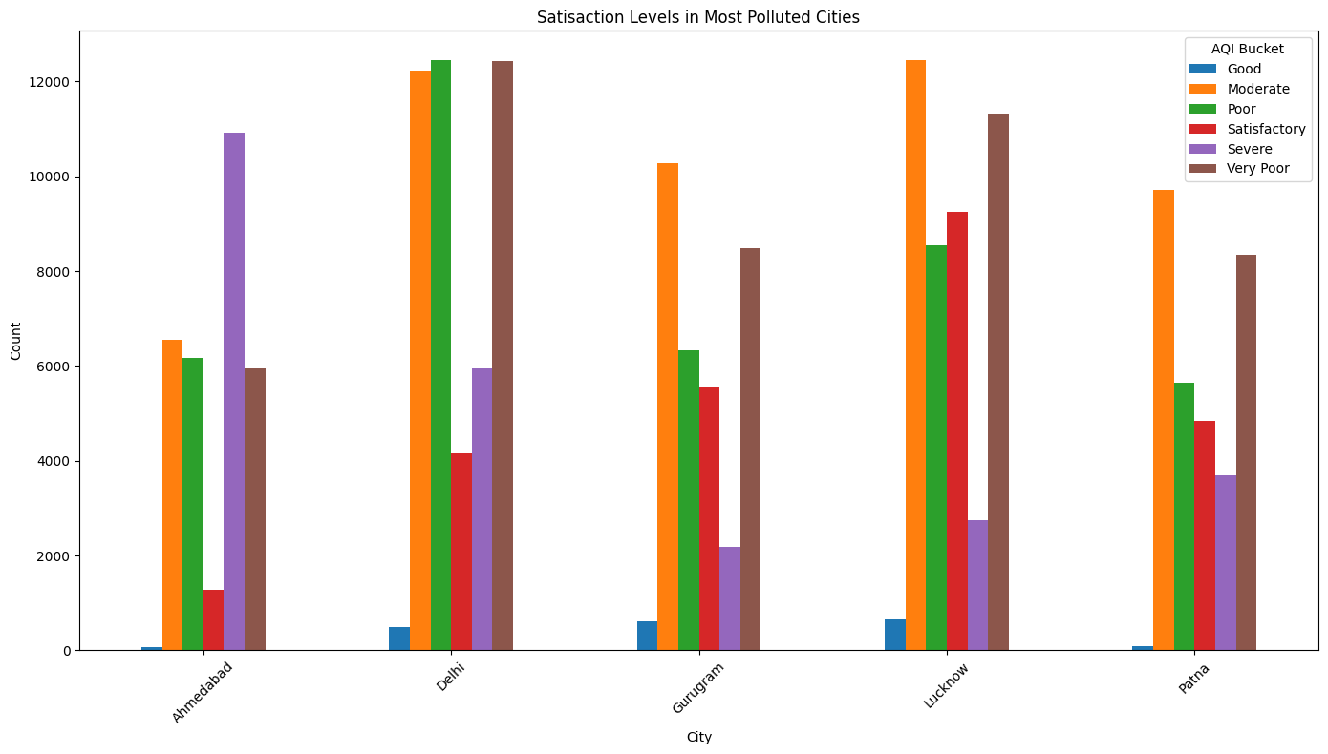
EDA - City-wise Analysis

Slide 7
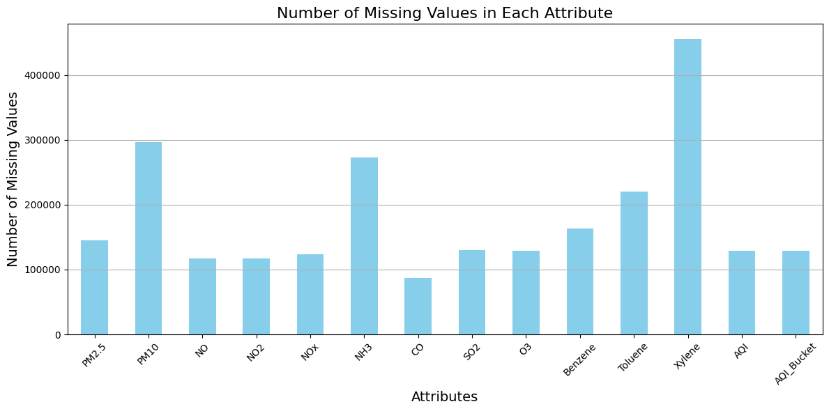
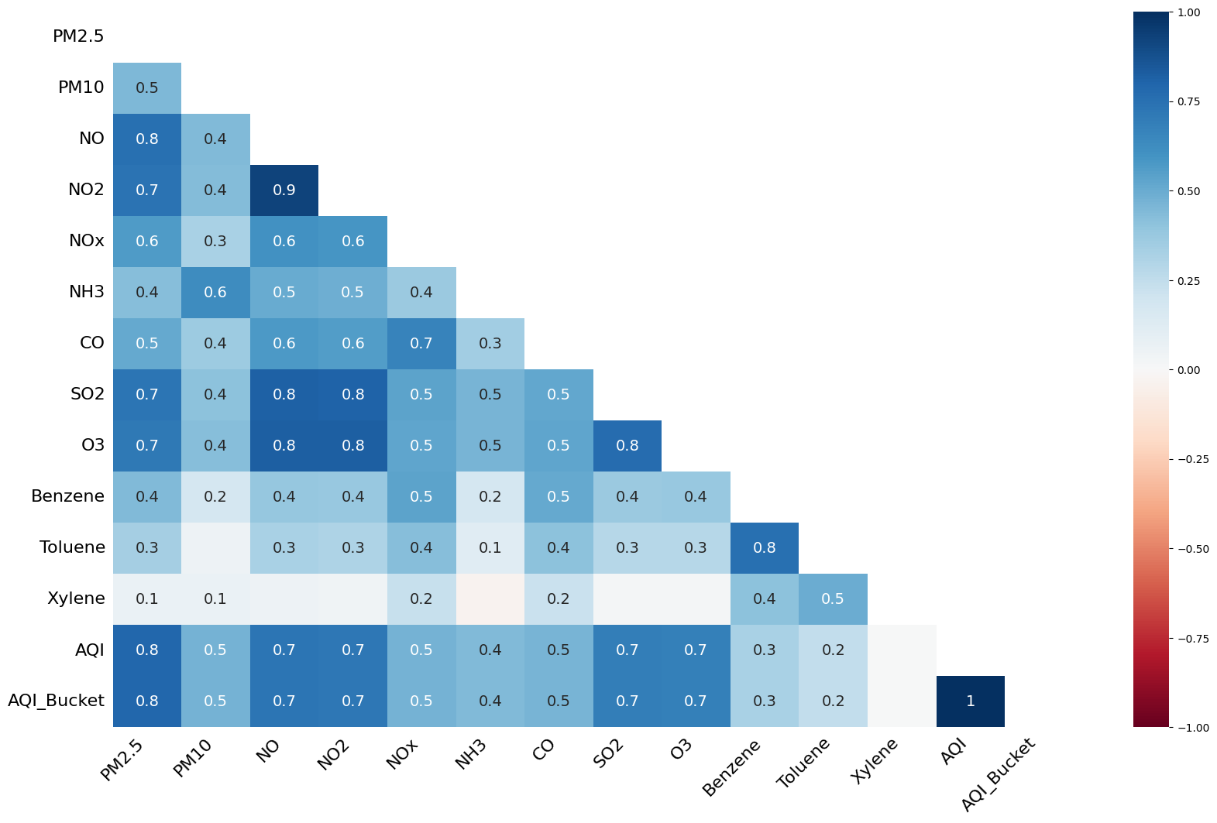
EDA - Missing Values Analysis
Purpose: EDA of the data set has revealed the statistical summary of the data, helped in checking missing values, helped observe trends of pollution and satisfaction levels over time and in its distribution across cities.
High Variance: Daily AQI has a high variance over time axis which suggests that the daily levels of pollutions vary drastically.
Heatmap: The heatmap reveals the negative and positive correlation between different pollutants and gases.
Month-wise Analysis: The graph of AQI over months has an upward curve at both ends, suggesting that pollution is higher in the winter months.
Year-wise Analysis: Average AQI has been decreasing over the years, especially in post-covid years.
City-wise Analysis: Satisfaction levels align with pollution: "Good" AQI is low across all cities, while "Severe" and "Poor" levels dominate in the most polluted areas. In contrast, "Satisfactory" levels are more common in the least polluted cities.

Slide 8
Preprocessing
Preprocessing is critical for accurate AQI (Air Quality Index) prediction. Key steps include handling missing data, denoising, outlier removal, and scaling. Here’s an overview of each step
Missing Value Imputation: Filled missing values using forward fill, backward fill, and linear interpolation methods. It ensures complete datasets, reduces potential bias, and enhances data reliability.
Denoising: Applied a rolling mean with a window of 3 to smooth fluctuations. It reduces short-term variations, making patterns clearer and aiding model accuracy.
Outlier Removal: Identified and removed extreme values using Z-score thresholding. Prevents model overfitting to anomalies and improves prediction consistency.
Min-Max Scaling: Scaled all numeric features between 0 and 1. Enhances model convergence speed and prevents features with larger ranges from dominating model learning.

Slide 9
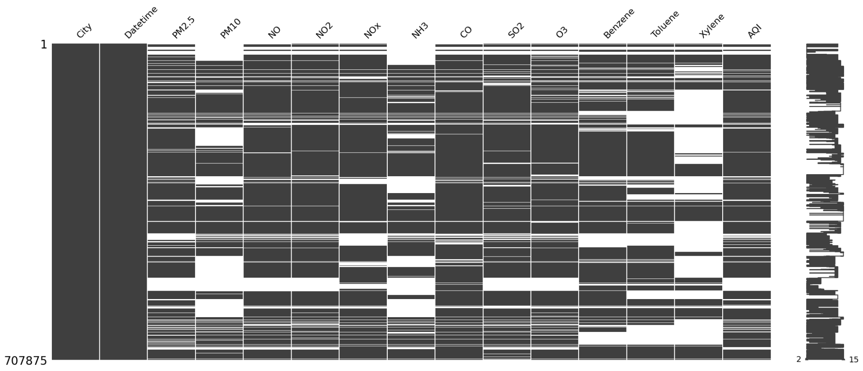
Some Insights
Preprocessing improves data quality and model performance by handling missing values, smoothing noise, removing outliers, and scaling features. These steps ensure a cleaner, more balanced dataset, leading to more reliable and accurate model predictions.

Slide 10
Hypothesis Tests
Hypothesis testing is a statistical method used to determine whether there is enough evidence to support a specific claim or hypothesis about a population parameter based on sample data. It is essential for making informed decisions and drawing conclusions in various fields, such as medicine, psychology, and social sciences. By assessing the strength of evidence against a null hypothesis, researchers can evaluate the validity of their assumptions and contribute to scientific knowledge.

Slide 11
Shapiro test
In my analysis, I applied the Shapiro-Wilk test to assess the normality of the Air Quality Index (AQI) data. The null hypothesis (H0) posits that the AQI data follows a normal distribution. However, my results indicated that I should reject this hypothesis, as the p-value was less than the significance level of 0.05.
This finding suggests that the AQI data does not conform to a normal distribution. Understanding the distribution of the AQI is crucial because many statistical analyses assume normality. Consequently, this result may necessitate my use of non-parametric methods for further analysis or the transformation of the data to meet the assumptions of normality.

Slide 12

Hypothesis Testing Result: ANOVA on AQI Across Cities
Null Hypothesis (H0): There is no significant difference in Air Quality Index (AQI) among the various cities. Alternative Hypothesis (H1): There is a significant difference in AQI among the various cities.
The ANOVA results indicated a significant difference in AQI levels across cities, leading to the rejection of the null hypothesis.
This result suggests that AQI varies considerably between cities, highlighting the need for targeted interventions to address regional air quality issues. Further post-hoc analysis could identify specific cities with significant differences, providing insights necessary for effective policy-making and public health initiatives.

Slide 13
ANOVA Test Results for Air Quality Indicators
Null Hypothesis (H0): There is no significant difference in means among normalized PM2.5, NO, NO2, CO, and AQI.
Alternative Hypothesis (H1): There is a significant difference in means among normalized PM2.5, NO, NO2, CO, and AQI.
The ANOVA results indicated no significant difference in means among the normalized values of PM2.5, NO, NO2, CO, and AQI, leading to a failure to reject the null hypothesis. The p-value was 1.0, which is much greater than the significance level of 0.05.
This result suggests that the air quality indicators (PM2.5, NO, NO2, CO, and AQI) do not vary significantly in their means, implying that the sampled cities may have similar air quality characteristics in this dataset. This could indicate a uniformity in the air quality across the examined locations, but further investigation might be needed to explore other factors affecting air quality variation.

Slide 14
AQI Bucket Proportions Using Chi-Square Test
AQI Bucket is a categorical column that assigns a label to an entry based on its aqi value.The labels are as follows
Why We Conducted the Test
To answer the question of whether the observed AQI bucket proportions differ significantly from a uniform distribution (implying no skew) or if certain categories occur more frequently than others, indicating potential skewness.
Null Hypothesis (H0): The AQI bucket proportions are uniformly distributed, with no significant skew.
Alternate Hypothesis (H1): The AQI bucket proportions are not uniformly distributed, indicating a significant skew in AQI levels.
We performed a chi-square goodness-of-fit test to check if the observed AQI bucket counts differ from the expected counts (assuming a uniform distribution).

Slide 15
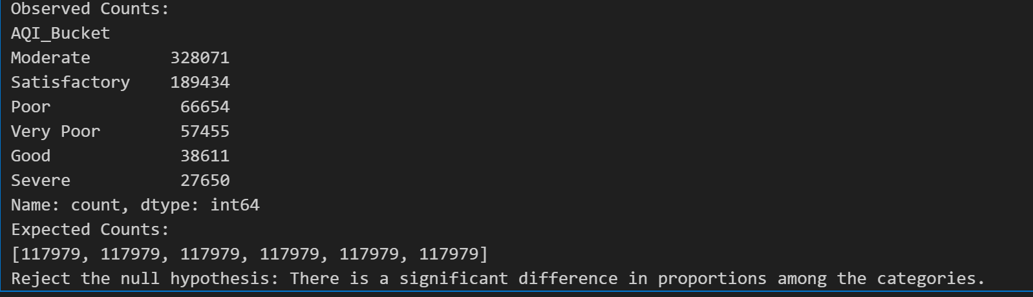
AQI Bucket Proportions Using Chi-Square Test
The results are as follows:-
Inference:-
The significant skew in AQI bucket proportions shows class imbalance, with "Moderate" and "Satisfactory" dominating. To improve model performance, we can consider resampling, adjusting class weights,

Slide 16
Dependency Analysis of Chemical Attributes Using Chi-Square Test
Why We Conducted the Test
To improve AQI prediction accuracy, we analyzed whether chemical attributes (like PM2.5, NO2, and CO) are statistically dependent. Identifying dependencies helps us understand relationships between pollutants, which could refine our predictive model.This dependency analysis enables better feature extraction and selection, allowing us to focus on independent variables that contribute uniquely to AQI variations.
Null Hypothesis (H0): There is no association between each pair of chemical attributes.
Alternate Hypothesis (H1): There is an association between each pair of chemical attributes
If the test statistic is greater than the adjusted critical value, we reject the null hypothesis (indicating a significant association)
Each chemical attribute's values are categorized into four equal-sized bins (quartiles) to create discrete categories, which makes them suitable for the chi-square test. The code then performs pairwise chi-square tests to evaluate dependency, adjusting for multiple comparisons. Finally, it identifies and lists pairs of chemical attributes that show statistically significant dependencies.

Slide 17
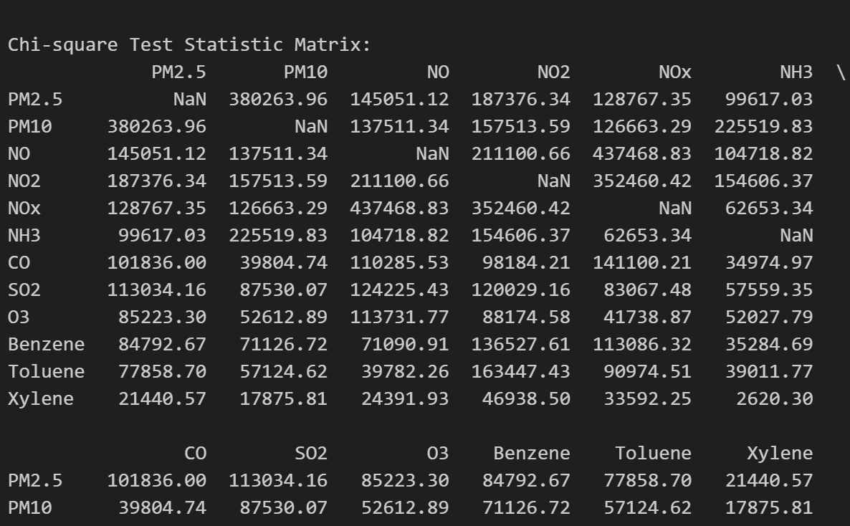
Dependency Analysis of Chemical Attributes Using Chi-Square Test
No of dependent pairs=52
The result of 52 dependent pairs among chemical attributes suggests significant interrelationships, likely due to shared sources or environmental interactions. This dependency can introduce redundancy in the data, which may affect model performance due to collinearity. To address this, we can consider dimensionality reduction or feature selection to retain essential information without redundancy, leading to a more effective AQI prediction model.

Slide 18
MODEL
Random Forest Regression for AQI Prediction
Objective: Predict Air Quality Index (AQI) using a time series approach based on various pollutants.
Why Random Forest?
Handles non-linear relationships effectively.
Robust to overfitting with many trees.
Provides feature importance metrics.
Why PCA?
Dimensionality Reduction:
Reduces the feature space while retaining 95% variance.
Helps mitigate the curse of dimensionality, leading to better model performance.
Enhanced Interpretability:
Transforms correlated features into a set of uncorrelated principal components.

Slide 19
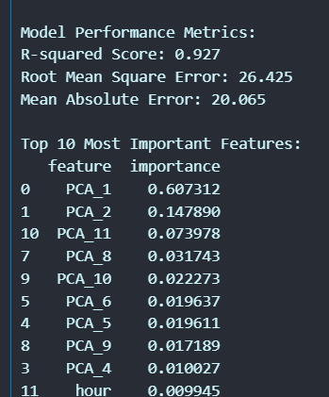
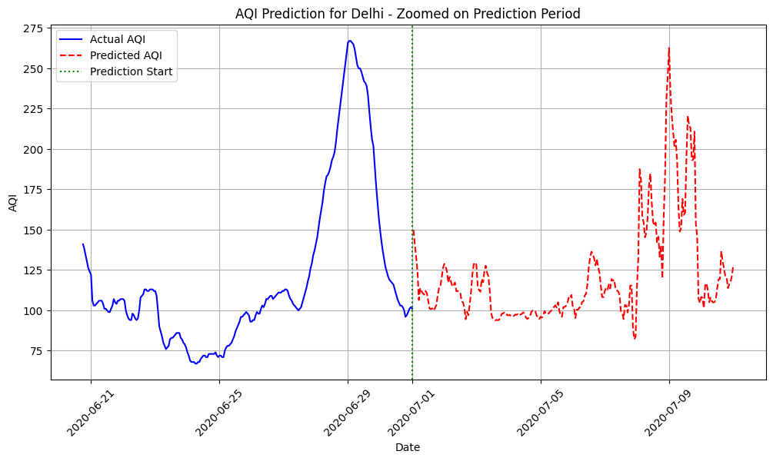
Results
From Results we see Model works well on processed data.

Slide 20

Moving Towards Deep Learning
To Efficiently work we moved towards DL .
As we advance our approach, we're leveraging Deep Learning techniques to enhance the prediction of Air Quality Index (AQI) for various cities.
By transitioning from traditional machine learning models to neural networks, we aim to capture complex, non-linear relationships in the data.
This enables us to account for temporal patterns, seasonal variations, and spatial dependencies, improving the accuracy and robustness of our AQI predictions.

Slide 21
What we did?
Developed a Deep Learning-based Regression Model to predict AQI values for multiple cities.
Used a time-series grouped train-test split to preserve temporal integrity in city-wise data.
Normalized features using MinMaxScaler and utilized PyTorch for model implementation.
Model architecture: 3 fully connected layers with ReLU activations.
Trained with Adam optimizer and MSE loss over 200 epochs.
Model Evaluation Metrics: The model trained on importance-sampled coresets was evaluated using the test dataset. The performance metrics were:
Mean Squared Error (MSE): Indicates the average squared error between predictions and actual values.
Mean Absolute Error (MAE): Reflects the average absolute prediction error.
R² Score: Measures the proportion of variance in the target variable explained by the model.

Slide 22
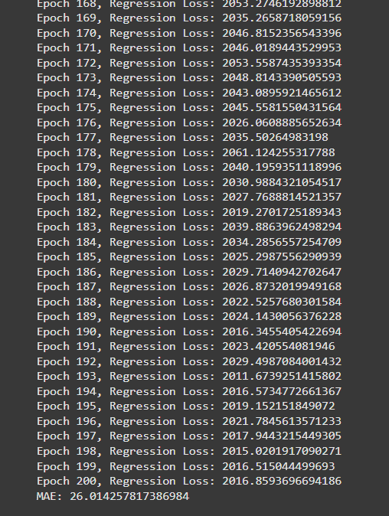
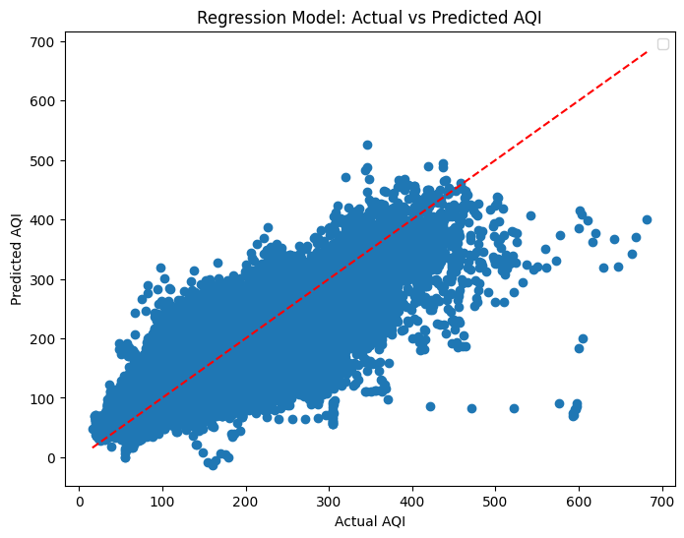
Results on Actual Dataset

Slide 23

Analysis
The regression model for predicting AQI achieved a Mean Absolute Error (MAE) of 26.01, indicating that the model predicts AQI values with a moderate average error. The R² score of 0.7829 suggests that the model explains approximately 78.3% of the variance in the AQI data, reflecting a strong correlation between the predicted and actual values.
The training process demonstrated stable loss convergence over epochs, with the final Regression Loss around 2016.86, showing consistent learning without significant overfitting. However, the relatively high loss values suggest that there may still be room for improvement in feature engineering, hyperparameter tuning, or model architecture.
Overall, the model performs well but could benefit from further optimizations to reduce the prediction error and enhance its ability to generalize across different city datasets.

Slide 24

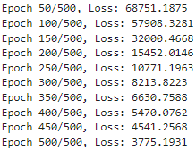
Dataset Reduction using Coresets(K-Means)
a)Why Use k-Means Clustering for Coresets?
k-Means clustering creates representative subsets by grouping data points into clusters, with each cluster's center acting as a proxy for its members. This approach ensures that the dataset's structure is preserved while dramatically reducing its size. Coresets generated in this way provide a balance between data reduction and fidelity to the original dataset.
b)Determining the Optimal Number of Clusters:
The optimal number of clusters balances data fidelity with computational efficiency. This is achieved by calculating the reconstruction error, which measures the average minimum distance between data points and their closest cluster centers. By plotting reconstruction error against the number of clusters, we identify a point where adding more clusters yields diminishing returns—commonly referred to as the "elbow point." This ensures an effective trade-off between data representation and processing cost.
c)Running the Model:-
Identifying 2000 as the optimal no of cloisters, we finally ran the above described nn with lr=10^-2 and no of epochs=500.
Trained only on Delhi’s Data

Slide 25
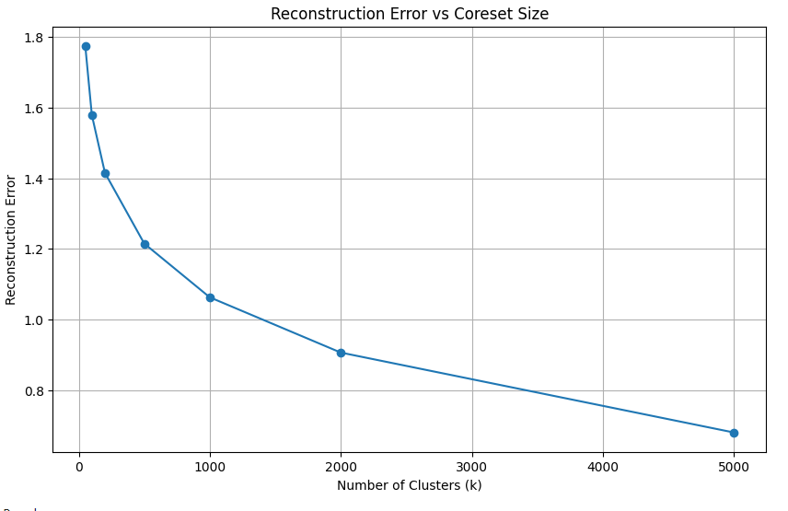
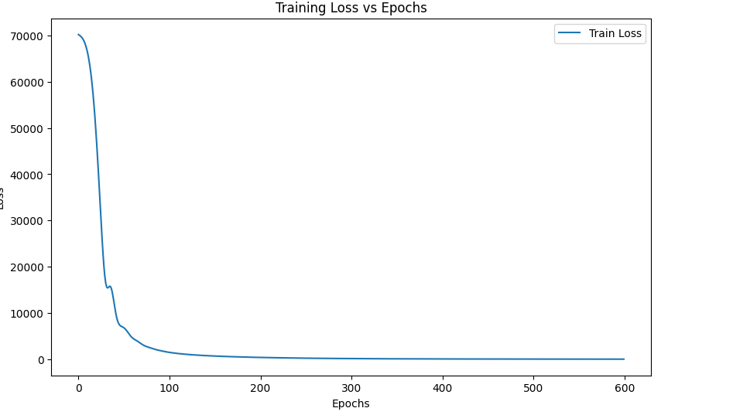

Dataset Reduction using Coresets(K-Means)
Results
The results demonstrate the effectiveness of the coreset reduction technique in maintaining regression performance while reducing computational complexity. A Mean Squared Error (MSE) of 136.8305 and a Mean Absolute Error (MAE) of 5.8286 indicate that the model's predictions are closely aligned with actual values, with minimal deviations. The high R² score of 0.9874 further validates that the model explains approximately 98.74% of the variance in the target variable, showing that the coresets successfully preserve the essential structure of the dataset. These metrics collectively highlight that the clustering-based coreset approach achieves an optimal trade-off between efficiency and accuracy, making it a robust strategy for large-scale regression tasks.

Slide 26
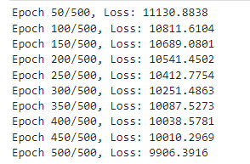
Dataset Reduction using Coresets(Importance Sampling)
Why Importance Sampling?
Importance sampling is used to select a representative subset (coreset) of the data that emphasizes points with higher variability or importance relative to the mean of the dataset. By assigning sampling probabilities based on distances from the mean, this method ensures that more significant points (those further from the mean) are included in the coreset. This approach helps retain the essential structure of the data, improving model performance while reducing computational costs.
Reconstruction Error Analysis:
Reconstruction error was calculated by measuring how well the coreset approximates the original dataset. The Mean Squared Error (MSE) between the original and reconstructed datasets was plotted against various coreset sizes. The results show that as the coreset size increases, the reconstruction error decreases, confirming that larger coresets retain more information from the original data. However, the diminishing returns observed at higher coreset sizes emphasize the need for a balanced selection.
Trained only on Delhi’s Data

Slide 27
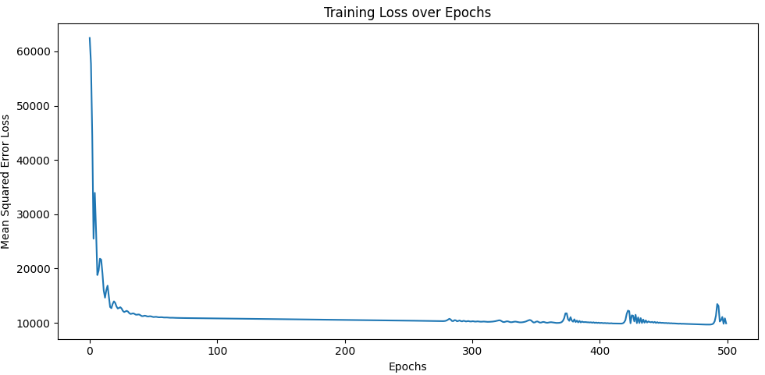
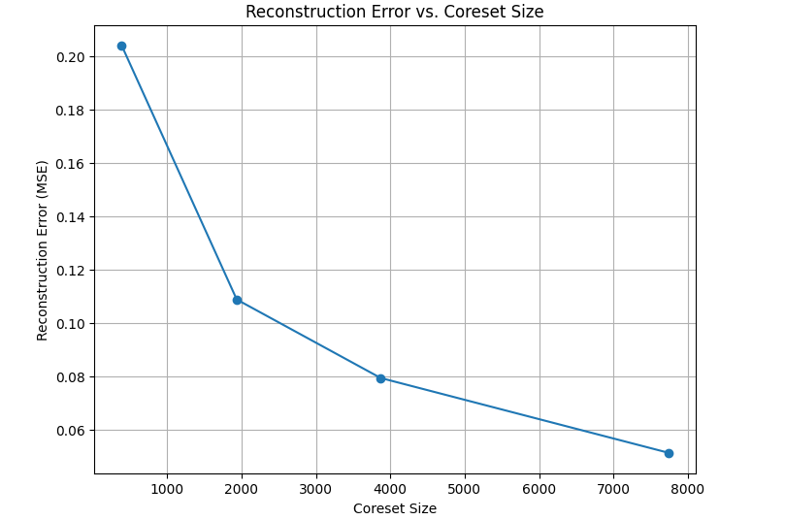

Dataset Reduction using Coresets(Importance Sampling)
Results:-
The results of the model trained using importance-sampled coresets highlight areas for improvement. The Mean Squared Error (MSE) of 7889.10 and the Mean Absolute Error (MAE) of 74.51 suggest that the model's predictions deviate significantly from actual values, indicating a notable loss of fidelity during coreset sampling. Additionally, the R² score of 0.2763 shows that only 27.63% of the variance in the target variable is explained by the model, which is relatively low. These results suggest that while importance sampling reduced the dataset's size and computational burden, it may not have captured enough of the data's critical patterns, particularly for a complex target like AQI. Further tuning of the sampling probabilities or increasing the coreset size might be necessary to improve the balance between efficiency and predictive performance.

Slide 28
Dataset Reduction using Peaks
Peak Detection for Dataset Reduction
Objective: Reduce the dataset size while retaining significant data points for AQI prediction.
Method: Used Scipy's find_peaks function to detect peaks in PM2.5 for each city. Peaks correspond to significant pollution events.
Retained only rows corresponding to these peaks for model training and evaluation, creating a more focused dataset.
Advantages:
Highlights critical data points for air quality assessment.
Reduces computational load during training.
Ensures the model prioritizes events that impact AQI significantly.
Challenges:
Potential loss of non-peak data affecting AQI variations.

Slide 29
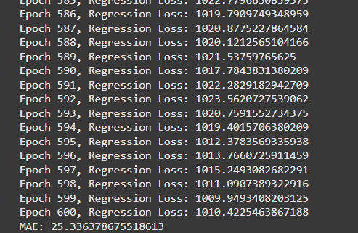
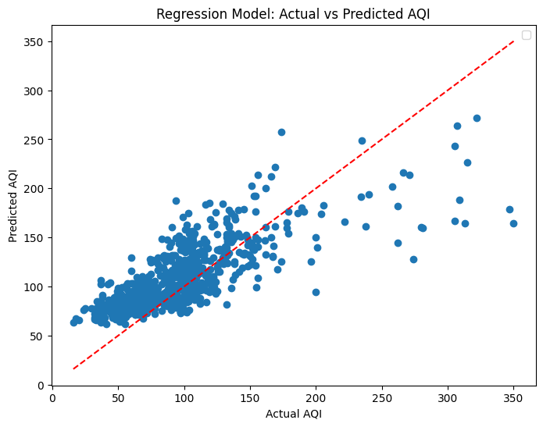

Results

Slide 30
Analysis
Performance Metrics:
Mean Absolute Error (MAE):
MAE on the reduced dataset: 25.34.
MAE on the full dataset: 26.01.
The reduction in MAE indicates improved precision in predicting AQI for retained data points.
R² Score:
R² on the reduced dataset: 0.53.
R² on the full dataset: 0.78.
The lower R² suggests that the model now explains significantly less variance in AQI.
Insights from Metrics:
The improved MAE implies that the model handles extreme pollution events (peaks) better after dataset reduction.
The decline in R² reflects the model's inability to capture the overall variability in AQI, likely due to the absence of non-peak data. This indicates a trade-off between precision for peak events and generalization.

Slide 31


Dimensionality Reduction using SVD
Dimensions:
Original number of dimensions, d = 12
Order of Original Data: 38709 x 12
Number of dimensions after dimensionality reduction, n_components = 6
Transformed Data: 38709 x 6
Applying SVD:

Slide 32

Dimensionality Reduction using SVD
Deciding Value of n_components
While deciding the value of the parameter, n_components, i.e. the number of dimensions in the transformed data matrix, there is a tradeoff between amount of information retained and the computational cost for subsequent training of the model. This is computed using Cumulative Explained Variance, which captures the cumulative percentage of variance captured by the principal components. For n_components =6, the cumulative variance captured by the components summed to more than 80%.
Results:
Results

Slide 33
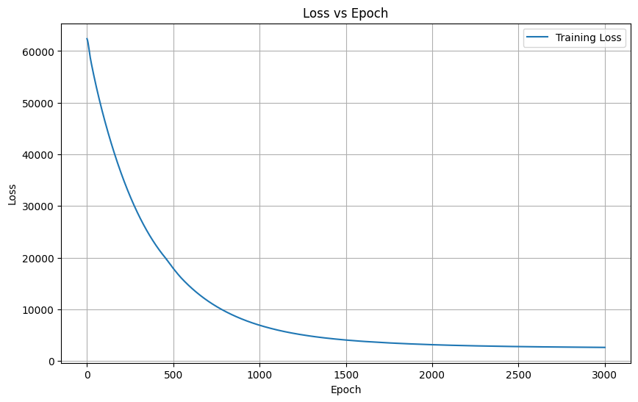
Dimensionality Reduction using SVD
Decreasing Training Loss with Number of Epochs Graph

Slide 34
Dimensionality Reduction using JL LEMMA
1. Load and Preprocess Data
Load the CSV file into a DataFrame using pandas.
Drop irrelevant columns (City, Datetime, AQI_Bucket).
Separate inputs (PM2.5, PM10, ..., Xylene) and output (AQI).
2. Apply Johnson-Lindenstrauss (JL) Lemma for Dimensionality Reduction
Use a random projection matrix to reduce the 12 input features to 6.
3. Define an Artificial Neural Network (ANN)
Create an ANN using PyTorch with:
Input layer: 6 dimensions.
Two hidden layers with 32 neurons each and tanh activation.
Output layer: 1 neuron for AQI (regression task).

Slide 35
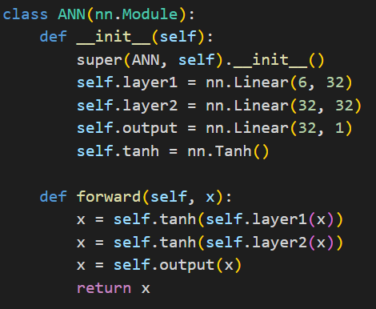
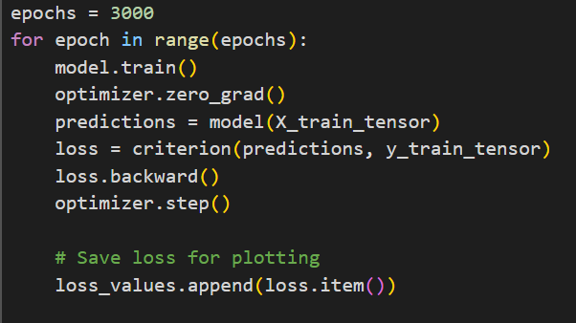
Dimensionality Reduction using JL LEMMA

Slide 36

Dimensionality Reduction using JL LEMMA
Mean Absolute Error (MAE): 41.2192
Root Mean Squared Error (RMSE): 55.4864
R-squared (R²): 0.7198

Slide 37
Colab Links
JL Lemma
SVD Decomposition
Peaks reduction and Ann on Full Dataset
Coresets using k means and importance sampling

Slide 38

Thank You

